Slide 1
Competitive
Programming
Lesson 2 - Time Complexity + PSA
Written by Jason Sun and Puneet Bhat

Slide 2
1
Time Complexity
How can we measure speeds?

Slide 3
Time?
What is time complexity?
It is a way for us to generalize and easily understand the speed of an algorithm or task.
We want to do things fast, so we don’t exceed the time limit, which is put to disallow slower, unintended/incorrect implementations from passing. To show time complexity, we use something called Big O notation.

Slide 4
O(1)
O(n)
O(n²)
O(log n)
Common Examples
Constant Time
Linear Time
Quadratic Time
Logarithmic Time
Example
Doing simple arithmetic operations
Accessing a specific element in an array through indices
Example
Finding the min or max of an array
Finding the sum of an entire array
Checking string equality
Example
Finding all unique pairs in an array
Finding the fastest
Comparing elements in two different arrays
The fastest speed for:
Binary search (to appear in the future)
Storing a number as a string

Slide 5
(REFER BACK)
What is the time complexity of the optimal solution to this problem from our last lesson?
Your friend Bob needs help counting. He gives you an integer n.
Output the integers from 1 to n, all on different lines, in ascending order.
Output needs to be exact. Example on the right.
INPUT
4
OUTPUT
1
2
3
4

Slide 6
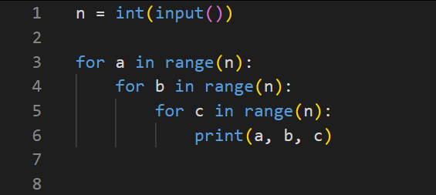
(KNOWLEDGE)
What is the time complexity of the code below?
Notes:
O(n^3)

Slide 7
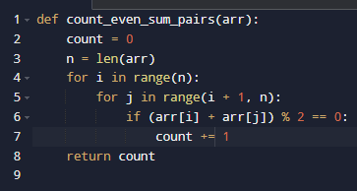
(THINKING)
What is the time complexity of the code below?

Slide 8
Operations
You can kinda use time complexity to more accurately tell if your code will pass or not.
Most judges do 1 billion operations per second
So if your code runs in O(n²) time and the constraints are
0 <= n <= 1000, meaning n will only be going up to 1000
In the worse case: total time = n^2 = 1000^2 = 1,000,000
Since you will be doing 1 million operations in total, and that is less than one billion, it will probably be enough!
(Given that the time limit is 1 second, but if say the time limit was 2 seconds, then you need to be under 2 billion operations).

Slide 9
2
Prefix Sum Arrays
Putting your new time complexity knowledge to the test! Showing you the benefit of considering time complexity?

Slide 10
Question
But we can actually solve this faster! The easiest solution is too slow.
If I gave you an array of 1 million numbers, then every query we answer will take O(n) time since you have to go through each number and sum them up! This is okay for one query, but if they ask for many queries then that will take too long.
Total Operations = Going Through Every Query * Time it Takes to Find Sum per Query
So what’s the time complexity of our solution?
Given a list of numbers, and some queries of a ranged sum, print the sum of that range.
Example
Given [4, 1, 0, -2, 5, 9, 3]
And asked (inclusive range) (0-indexed)
Sum of index 3 to 3?
Sum of index 1 to 4?
Sum of index 0 to 6?
Notes:
Sum of index 3 to 3? (-5)
Sum of index 1 to 4? (4)
Sum of index 0 to 6? (20)

Slide 11
O(n²)
But for the same problem, we can actually improve it to O(n) time.

Slide 12
Prefix Sum Array
Given array A = [2, 3, 4, 1]
The PSA of A would be [2, 5, 9, 10]
In the PSA
Index 0 is the sum of A’s element 0
Index 1 is the sum of A’s elements 0, 1
Index 2 is the sum of A’s elements 0, 1, 2
Index 3 is the sum of A’s elements 0, 1, 2, 3 (the sum of the whole array)
Awesome! The PSA will help us, and you can start thinking about how using the PSA will let us instantly find the sum of a range in a list. But first off, how do you make it?
Well you could just sum up 0 to 0 for the first index, 0 to 1 for the second index, until your done. But that takes O(n²), which is too long, the same long time as our previous solution.

Slide 13
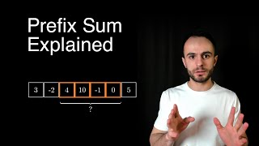
Creating the PSA
We can actually use the PSA to create itself! What do I mean, well, if we want to calculate psa[i]
psa[i] = psa[i-1] + A[i]
A = [2, 3, 4, 1]
psa = [2] (we start with the first element of A)
To find psa[1] we can add [2, 3, 4, 1] = 2 + 3 = 5
psa = [2, 5]
To find psa[2] we can add [2, 3, 4, 1] = 5 + 4 = 9
psa = [2, 5, 9]
And so on.
Prefix Sum Array and Range Sum Queries
By Profound Academy
https://www.youtube.com/watch?v=xbYr9JOC2Lk

Slide 14
Using the PSA
Sum of range calculation is: blue - red = result (sum)
A = [2, 3, 4, 1]
psa = [0, 2, 5, 9, 10] (tip: add 0 at the start so you don’t need to check for out of bounds cases)
Sum of index 0 to 2:
[0, 2, 5, 9, 10]
Sum of index 1 to 3:
[0, 2, 5, 9, 10]
Sum of index 2 to 2:
[0, 2, 5, 9, 10]
More Information on PSA! Check it out if you want :D
https://usaco.guide/silver/prefix-sums

Slide 15
^.^
Practice
If you want to improve, practice! Do the homework! If you want to be really good, do some DMOJ questions outside of class/homework too. You can also take competitive programming classes to keep you accountable.

Slide 16
Homework
Junior (~5p)
1) Warm Up - Total Sum - https://dmoj.ca/problem/nccc3j1
2) CCC '24 J3 - Bronze Count - https://dmoj.ca/problem/ccc24j3
3) Lil' Jami - https://dmoj.ca/problem/liljami
4) DMOPC ‘14 Contest 2 P4 - https://dmoj.ca/problem/dmopc14c2p4
Senior (~7p)
1) CCC ‘24 J4 - Troublesome Keys - https://dmoj.ca/problem/ccc24j4
2) James's Egirl Discord Status - https://dmoj.ca/problem/bsspc21s3
3) Crayola Lightsaber - https://dmoj.ca/problem/bfs17p2
4) OTHS Mock CCC J4 - Railgun - https://dmoj.ca/problem/othscc1p4

Slide 17
Thanks!
Do you have any questions?
Jason Sun - 350702866@gapps.yrdsb.ca
Puneet Bhat - 349068395@gapps.yrdsb.ca
https://github.com/CryoJS

